Slide 1
Scientific Research in Information Systems
Chapter 5
5.2 QualItatIve Methods
RESEARCH mETHODS
JAN RECKER

Slide 2
Overview
Research Methods
Quantitative Methods
The Focus on Measurement
Reliability
Validity
Measurement Development
Quantitative Method Procedures
Survey Research
Experimental Research
Qualitative Methods
Data Collection Techniques
Data Analysis Techniques
Case Study
Action Research
Grounded Theory
Mixed Methods and Design Science Methods
Mixed Methods
Design Science Methods
Further Reading

Slide 3
Qualitative Methods
Qualitative methods are designed to assist researchers in understanding phenomena in context.
Qualitative methods, have been developed in the social sciences to enable researchers to study social and cultural phenomena.
Examples include case study research, action research, and grounded theory, amongst others.
While quantitative methods focus on numbers qualitative methods focus on text, most importantly text that captures records of what people have said, done, believed or experienced about a particular phenomenon, topic, or event.
Compared to quantitative research, qualitative methods employ different philosophical assumptions, techniques for data collection, and techniques for analysis and interpretation.
Notes:
Qualitative methods are strategies of empirical inquiry that investigate phenomena within a real-life context.
They are helpful especially when the boundaries between phenomena and context are not apparent, or when you want to study a particular phenomenon in depth.
They are well suited for exploratory research where a phenomenon is not yet fully understood, not well researched, or still emerging.
They are also ideal for studying social, cultural, or political aspects of a phenomenon (for example, related to information technology in use).

Slide 4
Qualitative Methods (Cont.)
A number of characteristics of qualitative methods:
Natural setting: Qualitative research is performed in the field, studying a phenomenon in the context in which it occurs.
Researchers as a key instrument: Qualitative researchers collect data and information themselves (rather than through an ‘objective’ instrument), often through face-to-face interactions, observing behaviors, studying documents, or interviewing participants.
Multiple sources of data: Qualitative researchers typically gather a variety of data of different sorts, from interviews to documents to observations and so forth.
Inductive analysis: Qualitative methods emphasize bottom-up analysis of data and the build-up of patterns, themes, and concepts into increasingly abstract units from the data.
Notes:
Qualitative methods are often also called interpretive research methods because of the typical focus on the development of interpretations of data.

Slide 5
Qualitative Methods (Cont.)
A number of characteristics of qualitative methods (Cont.):
Focus on emergent meaning: Qualitative methods focus on uncovering or learning the meaning of behaviors, opinions, or views that participants have about a phenomenon.
Evolutionary design: Qualitative methods, while following a general procedure, typically follow an evolutionary research process in which a research plan, a theory, data collection, or analysis can unfold and change over time as the research progresses.
Interpretive: Qualitative methods often consist of interpretive research in which researchers develop interpretations of the data they collect and analyze, often in the form of suggested conceptualizations of theories about the phenomenon of study.
Holistic and contextual: Qualitative methods are designed to assist researchers in developing a comprehensive, detailed picture of complex phenomena.
Notes:
Qualitative methods are often also called interpretive research methods because of the typical focus on the development of interpretations of data.

Slide 6
Qualitative vs. Quantitative
Because of the emphasis on non-numerical data (“text”), qualitative research is not as amenable to quantitative analyses such as statistics and instead primarily relies on other analysis techniques such as ethnography, content analysis, or discourse analysis.
Another key difference between qualitative and quantitative methods is the purpose of sampling.
Quantitative methods rely on random sampling where cases are selected randomly from a wider population.
Qualitative methods by contrast rely on purposive sampling, where cases are selected because they possess certain properties of interest.
A major disadvantage of qualitative research methods is the difficulty in generalizing to a larger population.
Moreover, qualitative methods require the appropriate skills and experience because the interpretive nature of such research makes it strongly susceptible to subjective interpretation bias.

Slide 7
Data Collection Techniques
Qualitative methods employ a variety of techniques to gather data.
The most prominent form is certainly interviewing, either face-to-face, one-to-many (in focus groups) or via telephone/conferencing.
Interviews can be descriptive, exploratory, or explanatory.
Descriptive interviews are used to provide a rich description of a phenomenon as perceived by individuals.
Exploratory interviews are typically used to define questions, propose new theory constructs, and/or build new theories.
Explanatory interviews, on the other hand, are performed in causal studies, for instance to determine whether presumed and/or postulated relationships and causal links between concepts or constructs do in fact occur and are perceived as such in real life settings.

Slide 8
Data Collection Techniques (Cont.)
Semi-structured interviewing is thus guided only in the sense that some form of interview protocol provides a framework for the interview.
To that end, semi-structured interviews exhibit a number of benefits over other interviewing approaches:
They are less intrusive to those being interviewed because semi-structured interviews encourage two-way communication. For instance, those being interviewed can ask questions of the interviewer.
They can be used to confirm what is already known whilst at the same time providing the opportunity for learning. Often the information obtained from semi-structured interviews will provide not just answers but also the reasons for the answers.
When individuals are interviewed personally and in a conversational rather than structured manner they may more easily discuss sensitive issues.

Slide 9
Data Collection Techniques (Cont.)
A second key technique is observation.
Direct observation involves the researcher as a passive and neutral bystander that is not involved in the phenomenon of interest (“looking over the shoulder”), whilst participant observation includes the researcher as an active participant (“influencing the phenomenon”).
A third key technique is documentation where all sorts of internal and external documents relating to the unit of observation are gathered and used as a data source.
These documents can be structured (spread sheets) semi-structured (emails, reports, policy documents, websites) or unstructured (music, video, other media).
There is a fundamental principle of qualitative research which is triangulation of data. Triangulation literally means doing more than just one thing.
Data triangulation refers to perusing, and relating, multiple sources of evidence about a particular phenomenon or topic.
Notes:
One of the key challenges in observation stems from the fact that we typically study unfamiliar contexts, requiring us to go through a period of enculturation in which we learn to become accustomed to the context that we are studying.
The documentation may also be personal, private, or public, which may impact access, use, or reporting of the data.

Slide 10
Data Analysis Techniques
There are many techniques for analyzing qualitative data. Some of them are:
Coding is probably the most commonly employed, popular, and vastly useful techniques for reducing qualitative data to meaningful information.
Coding refers to assigning tags or labels as units of meaning to pieces or chunks of data collected – words, phrases, paragraphs, or entire documents.
Memoing is typically used right after/together with data collection and is effectively a subjective commentary or reflection about what was happening at the time or place of the data collection.
Critical incidents analysis involves identifying and examining series of ‘events’ or ‘states’ and the transition in between (for instance in chronological order).
Content analysis is concerned with the semantic analysis of a body of text, to uncover the presence of dominant concepts. In general, content analysis approaches fall into two categories: conceptual and relational.
Discourse analysis looks at the structure and unfolding of a communication (such as a conversation, argument, or debate).
Notes:
There are many approaches to coding:
Open coding is a process aimed at uncovering and naming concepts from within data. Concepts may be grouped to higher-level categories to reduce the number of uncovered concepts on a higher level of conceptual abstraction.
Axial coding involves organizing categories and/or concepts into causal relationships, for example, to distinguish conditions from actions and interactions, and consequences.
Third, selective coding might then be used to identify from one to a few central categories and then systematically and logically relate all other categories to these central categories.

Slide 11
Data Analysis Techniques (Cont.)
Rigor in quantitative research (such as demonstrating validity and reliability of measurements through dedicated statistics such as Cronbach’s Alpha, cross-loadings, goodness-of-fit measures, etc.)
Several guidelines have been applied that cater more to the subjective and interpretive nature of qualitative methods. Key principles:
Dependability (aka reliability): Dependability concerns whether individuals other than the researchers, upon considering the same observations or data, would reach the same or similar conclusions.
Credibility (aka internal validity): Credibility of findings concerns whether the researcher has been able to provide sufficient substantiated evidence for the interpretations offered in qualitative data analysis (this relates to the internal validity of the research results).
Confirmability (aka measurement validity): confirmability is a principle that postulates that qualitative research findings can be independently verified by outsiders in a position to confirm the findings (typically participants).
Transferability (aka external validity): Transferability concerns whether and how much the findings from a study can be generalized to other settings, domains, or cases.

Slide 12
Case Study
Case study research is the most popular form of qualitative methods as well as the most well-established and published approach to research in information systems research and other social sciences, particularly business and management.
The case study method is a method involving intensive research on a phenomenon (a case) within its natural setting (one or more case sites) over a period of time.
A case study is commonly used to investigate a contemporary phenomenon within its real-life context, especially when the boundaries between phenomenon and context are not clearly evident.
Case studies are used both for confirmatory purposes (theory testing) and for exploratory purposes (theory building).
Notes:
Case study methods are designed for distinctive situations where there are many more variables of interest than data points and as a result case studies rely on multiple sources of evidence, where data needs to converge in a triangulating fashion. This is why case studies typically utilise multiple means of data collection (documentation, observations, interviews and/or secondary data).

Slide 13
Case Study (Cont.)
The main strengths of the case study method are that researchers:
Can study information systems-related phenomena in their natural setting,
Can learn about the state of the art and generate theory from practice,
Are enabled to understand the nature and complexity of processes, events,
actions and behaviors taking place, and
Can gain valuable insights into new, emerging topics.
Case study methods also have limitations;
with the most significant ones including problems of controlled deduction (a lack of adequate evidence to support evidences beyond any doubt),
problems of replicability due to the highly contextualized nature of inquiry,
and problems of control mechanisms to account for rival explanations or potentially confounding factors.

Slide 14
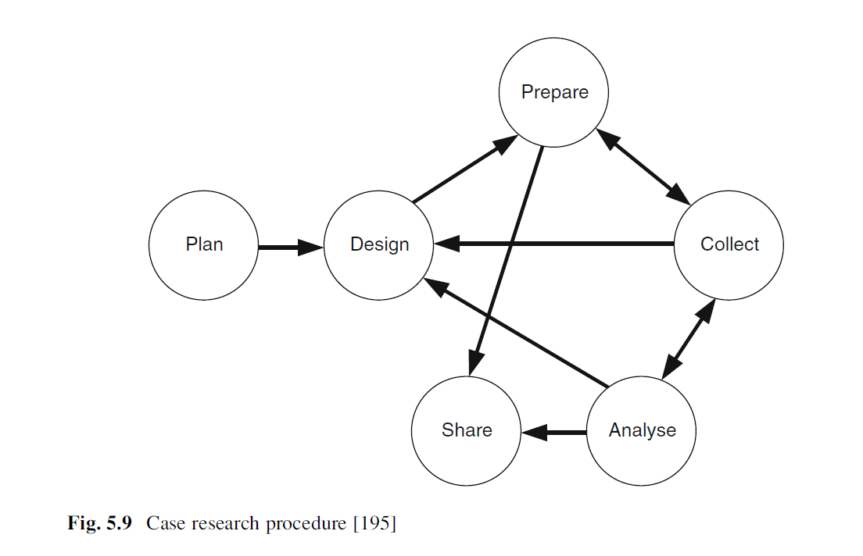
Case Study (Cont.)
Notes:
Planning refers to identifying the research questions and other rationale for doing a case study.
Designing refers to defining the unit of analysis, the number and types of cases to be studied, and the potential use of theory or propositions to guide the study.
Preparing involves taking the necessary steps to conduct high-quality data collection.
Collecting means executing the case study protocol(s) and gathering data, preferably from multiple sources.
Analyzing consists of examining, categorizing, coding, tabulating, testing or otherwise combining and studying the evidence collected to draw empirically based inferences and other conclusions.
Sharing refers to bringing case study results and findings to a close by identifying and addressing relevant audiences and providing them with the findings through appropriate reporting or presentation.

Slide 15
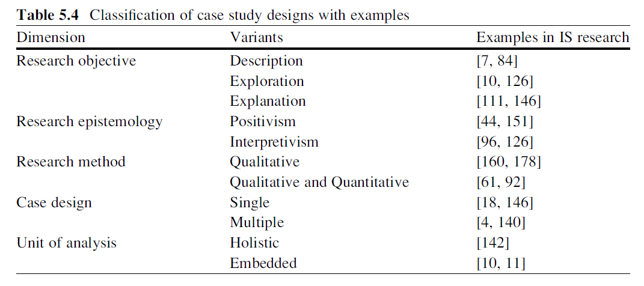
Case Study (Cont.)

Slide 16
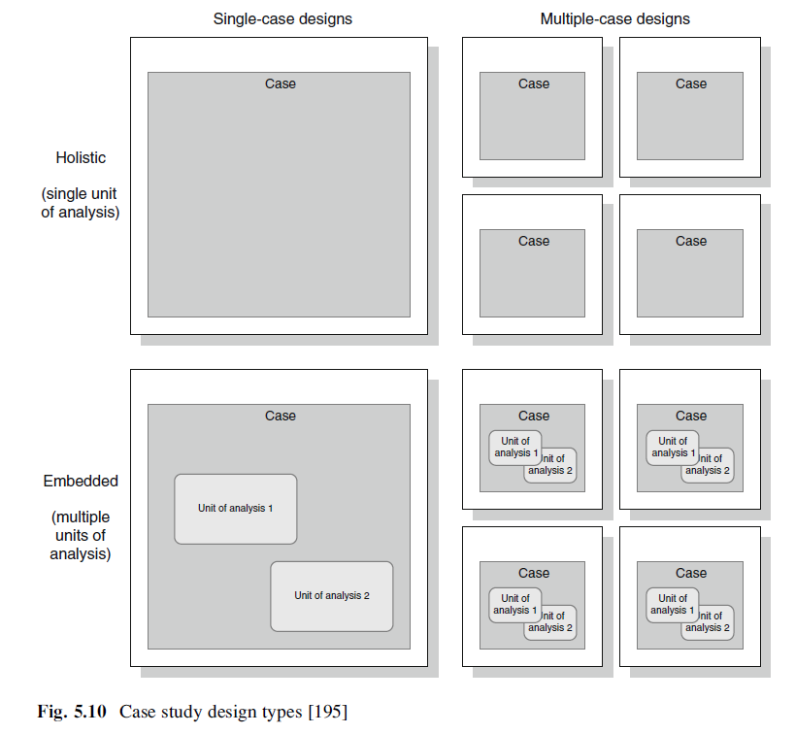
Case Study (Cont.)
Notes:
A single case study is preferable when the researcher wants to identify new and previously unchallenged phenomena or issues.
Multiple cases are desirable when it is the researcher’s intention to build or test a theory.
Embedded design means that there is more than one unit of analysis in a study of one or several cases related to the same object of investigation.
The holistic design is advantageous either when no logical subunits can be identified or when the theory itself is of a holistic nature.

Slide 17
Case Study (Cont.)
Like all other research methods, case studies need evaluation to assess the contribution offered to general knowledge in the area of study by the research.
Typically the following of guidelines are offered to reflect on the quality of case studies:
The case study must be interesting.
The case study must display sufficient evidence.
The case study should be complete.
The case study must consider alternative perspectives.
The case study should be written in an engaging manner.
The case study must contribute to knowledge.

Slide 18
Action Research
Action research is an interactive method of inquiry that aims to contribute both to the practical concerns of people in an immediate problem context and to the goals of social science by joint collaboration within a mutually acceptable ethical framework.
It builds upon the idea of introducing changes or other sorts of interventions into a context and studying the effects of those actions.
Importantly, the researcher acts as the agent of change or intervention (for example, in a role as consultant or organisational member) while also examining how these actions influence the phenomenon at hand.
In effect, action research attempts to solve current practical problems while simultaneously expanding scientific knowledge.
It involves research that produces immediate practical as well as academic outcomes and requires various degrees of integration between the researcher and the subject of the research.

Slide 19
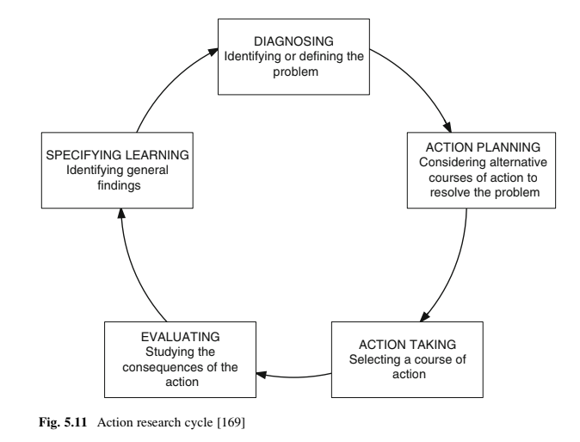
Action Research (Cont.)
Notes:
Diagnosing refers to identifying and defining the problem in context.
Action planning involves specifying the organisational actions that should be taken to relieve, mitigate, or rectify these problems. The researcher at this stage employs a theoretical framework that should explain why and how the planned actions will bring forth the desired change.
Action taking then implements the selected course of action.
Evaluating is the analysis of the actions and its consequences and considers whether the planned actions achieved their intended effects.
The last phase, specifying learning, describes what was learnt throughout the process, applies this knowledge within the organisation or other problem context, and also communicates it to the scientific community.
NOTE: Typically, this action research cycle is traversed at least twice so that learning from the first iteration can be implemented in the action planning, action taking, and evaluating phases of the second iteration.

Slide 20
Action Research (Cont.)
Several key principles guide the process of action research:
Establish the research infrastructure including formalizing the involvement of the organization and the responsibilities of the researcher and practitioners in a formal research agreement or contract that also specifies necessary legal and/or ethical arrangements.
Develop statements that describe the issue or problem to be addressed within a theoretical framework.
Plan and use methodological data collection methods and measurement techniques prior to taking action.
Avoid dominating the diagnosis and action planning phases by allowing subject learning to improve idiographic usefulness of any theory.
Undertake iterative cycles and record repetitive planning and action cycles. Report both action successes and failures as failures may provide more insights into learning and positive results.

Slide 21
Action Research (Cont.)
Several key principles guide the process of action research (Cont.):
Make restrained generalizations and use synchronic reliability to achieve consistent observations within the same time period.
Explain what happened in a factual and neutral manner. This means going through the cycle steps carefully, describing how the project arose, what was intended, the outcomes (intended and unintended, expected and unexpected) and their impact. Support the story by providing evidence of data recorded (such as organizational documents, feedback, performance metrics and the like).
Distinguish facts from value judgments and explicitly identify the researcher’s inferences and interpretations.
Make sense of what happened. Provide an analysis of what went on but also describe how it made sense as the story unfolds. Report assumptions and how they were tested, especially if the assumptions were private.
Explain how the project is contributing to theory or usable knowledge. Be able to demonstrate relevance of the project to the uninvolved reader.

Slide 22
Action Research (Cont.)
One of the main advantages of action research is the opportunity to contribute to both academic knowledge and to solving a real-world problem.
Thus, this method combines relevance and rigor in research.
This advantage, however, is also its biggest disadvantage, for doing action and research together is a challenging act for anyone, let alone an inexperienced scholar.
One of the key related challenges is assuming a position of a value-neutral, independent observer to the extent that it allows for critical reflection and analysis, while at the same time maintaining a role as an influencer and intervener.
Action research is evaluated based on contributions made to practice (the ‘action’) as well as the contributions made to theory (the ‘research’).

Slide 23
Grounded Theory
Grounded theory is a type of qualitative research that relies on inductive generation (building) of theory based on (“grounded in”) qualitative data systematically collected and analyzed about a phenomenon.
The grounded theory approach essentially attempts to explore for, and develop, generalized formulations about the basic features of a phenomenon while simultaneously grounding the account in empirical observations or data.
One of the key advantages – and challenges – of the grounded theory approach is that it is applicable to research domains that are new or emergent and may yet lack substantive theory.
The grounded theory method follows two primary principles.
First, the process of theory building is highly iterative, during which theory and data are constantly compared. This process is referred to as constant comparative analysis.
Second, grounded theory builds upon theoretical sampling as a process of data collection and analysis that is driven by concepts that emerge from the study and appear to be of relevance to the nascent theory.

Slide 24
Grounded Theory (Cont.)
Four main characteristics of grounded theory have been identified by Cathy Urquhart and her colleagues:
The main purpose of the grounded theory method is theory building, not testing.
Prior domain knowledge should not lead to pre-conceived hypotheses or conjectures about the research that the research then seeks to falsify or verify.
The research process involves the constant endeavor to jointly collect and compare data, and to constantly contrast new data to any emerging concepts and constructs of the theory being built.
All kinds of data are applicable, and are selected by the researcher through theoretical sampling.

Slide 25
Grounded Theory (Cont.)
There are two main strands of grounded theory: “Glaserian” and the “Straussian”
Differences between the two strands of grounded theory include the role of induction, deduction, and verification as well as coding procedures and the generated theories.
Both the “Glaserian” and the “Straussian” are in use today, and the debate continues about the relative merits and shortcomings between the two.
In pursuing grounded theory, the research process typically starts with collecting data, followed by the initial stage of data analysis through open coding.
The third phase is called theoretical coding and concerns the development of a substantive theory that includes inferences or tentative conjectures, propositions or hypotheses.

Slide 26
Grounded Theory (Cont.)
Advantages of grounded theory certainly include its tight and early immersion into data analysis – unlike, say, quantitative research where data analysis is typically conducted at a much later stage of the research process.
It encourages systematic and detailed data analysis and the literature provides ample guidelines for conducting these steps.
The main disadvantage of grounded theory also lies in the detailed and systematic bottom-up analysis of data.
It is very easy to get bogged down in data analysis on a very low level of detail, which makes it difficult to integrate to higher levels of abstraction.
The process and the grounded theory to be developed are dependent on both excellent and rich data and creative and critical thinking ability brought forward by the researcher.
Notes:
In fact, a widely held belief is that grounded theory is a particularly challenging method especially for early career researchers.

Slide 27
Further Reading
Glaser, B.G., Strauss, A.L.: The Discovery of Grounded Theory: Strategies for Qualitative Research. Aldine, Chicago (1967)
Hoaglin, D.C., Light, R.J., McPeek, B., Mosteller, F., Stoto, M.A.: Data for Decisions: Information Strategies for Policy Makers. Abt Books, Cambridge (1982)
Markus, M.L.: Electronic mail as the medium of managerial choice. Organ. Sci. 5, 502–527 (1994)
Myers, M.D.: Qualitative Research in Business and Management. Sage, Thousand Oaks (2009)
Myers, M.D., Newman, M.: The qualitative interview in IS research: Examining the craft. Inf. Organ. 17, 2–26 (2007)
Strauss, A.L., Corbin, J.: Basics of Qualitative Research: Techniques and Procedures for Developing Grounded Theory, 2nd edn. Sage, Thousand Oaks (1998)
Susman, G.I., Evered, R.D.: An assessment of the science merits of action research. Adm. Sci. Q. 23, 582–603 (1978)
Urquhart, C., Lehmann, H., Myers, M.D.: Putting the theory back into grounded theory: Guidelines for grounded theory studies in information systems. Inf. Syst. J. 20, 357–381 (2010)
Newell, A., Simon, H.A.: Human Problem Solving. Prentice-Hall, Engewood cliffs, New Jersey (1972)

Slide 28
Thank You
☺

